Slide 1
Financing a College Education
2025-26 Financial Aid Year

Slide 2
Agenda
Definition of financial aid, cost of attendance and student aid index
Financial need
Category/types of aid
Major financial aid programs
Free Application for Federal Student Aid (FAFSA®)
Special Circumstances

Slide 3
Goal of Financial Aid
Primary goal is to assist students in paying for their educational investment. It is achieved by:
  Evaluating family’s ability to pay for educational costs
  Distributing limited resources in an equitable manner
  Attempting to provide a balance of gift aid and self-help aid

Slide 4





What is Cost of Attendance (COA)
Room and board
Books and Supplies
Transportation
Miscellaneous personal expenses

Slide 5
What is the Student Aid Index
(SAI)?
Measurement of student’s and family’s ability to pay postsecondary educational expenses
Student contribution
Parent contribution
(for dependent students)

Slide 6
Financial Need Analysis
Cost of attendance (COA) – Student Aid Index (SAI) = Financial need

Slide 7
Need Varies with College Costs
College A Cost $40,000
Student Aid Index $ 5,000
Financial need $35,000
College B Cost $20,000
Student Aid Index $ 5,000
Financial need $15,000
  Net Price Calculator http://www.usnews.com/education/best-colleges/features/net-price-calculator or
  https://www.brockport.edu/admissions_aid/financial_aid/calculator.html

Slide 8
Categories of Financial Aid
Need-based aid
Non-need-based aid

Slide 9
Types of Financial Aid
Scholarship
Work-Study Employment
Loans
Grants
Self-Help
Aid
Gift Aid

Slide 10
Scholarships
Scholarship
Work-Study Employment
Loans
Grants
Self-Help
Aid
Gift Aid

Slide 11
Grants
Scholarship
Work-Study Employment
Loans
Grants
Self-Help
Aid
Gift Aid

Slide 12
Work Study
Scholarship
Work-Study Employment
Loans
Grants
Self-Help
Aid
Gift Aid

Slide 13
Loans
Scholarship
Work-Study Employment
Loans
Grants
Self-Help
Aid
Gift Aid

Slide 14
Federal Student Aid Identification (FSA ID)
Use for:
Federal financial aid identification
Filing of Free Application for Federal Student Aid (FAFSA)
Loan entrance and exit counseling
Signing of loan promissory notes
Access to National Student Loan Data System (NSLDS)
More to follow

Slide 15
FSA ID Continued
Who needs an FSA ID:
  Students, parents, and student’s spouse (if married)
  Do not share the FSA ID
  You may choose your own FSA ID
Obtaining a new FSA ID
  Apply at https://studentaid.gov
  FAFSA on the web
Already have a FSA ID
  Request a duplicate at https://studentaid.gov , FSA ID displayed online

Slide 16
Free Application for Federal Student Aid (FAFSA®)
A standard form that collects demographic and financial information about the student and family
May be filed electronically (FOTW)
Information used to calculate the student aid index (SAI)
Colleges use the SAI to offer Financial Aid
Available in English and Spanish
2025-2026 FAFSA uses 2023 taxable and untaxed income and current assets of both student and parent

Slide 17
General FAFSA Information
Used to calculate the Student Aid Index (SAI).
Students can list up to 20 schools on their FAFSA via the online application.
Applicants will be asked to report their sex, race, and ethnicity on the FAFSA itself, but students will be offered a choice of “Prefer Not to Answer”. Schools and states won’t see responses to these questions on the FAFSA.
Uses Federal Taxpayer Information (FTI) directly from the IRS

Slide 18
More FAFSA Information
Students, spouses, parents, and stepparents will now need to provide their consent in the new Consent to Retrieve and Disclose Federal Tax Information section of the FAFSA for federal student aid eligibility.
  This consent will allow the IRS to share FTI.
  If any party to the FAFSA form does not provide consent, submission of the form will still be allowed. However, a Student Aid Index (SAI) will not be calculated.

Slide 19

FAFSA on the Web
Web site: https://studentaid.gov
2025-26 FAFSA on the Web available December 2024
Built-in edits to prevent costly errors
Skip-logic allows student and/or parent to skip unnecessary questions
More timely submission process

Slide 20
Information Being Collected
For Student And Parent
Tax, income, and other financial information
Receipt of means-tested federal benefits
Assets
Untaxed income
Marital Status (parent)

Slide 21
Who is the Parent for the FAFSA?
Biological or Adoptive Parent(s)
  If not married BUT living together report BOTH parents
If parents are divorced:
  Provide information for the parent who provided you the most financial support during the last 12 months
Include Step-parent information
  Regardless of any ‘agreements’

Slide 22
Assets Included on the FAFSA
Cash, Savings, and Checking
Investments/Business/Farm Value
  Current/market value minus debt = Net Worth
  Real estate (not home you live in), trust funds, money market and mutual funds, CD’s, stocks, bonds, commodities
  Families who own a small business/farm that also serves as primary residence will now have assets of that business/farm considered in their need analysis calculation.
  Child support received.
  Education benefits/savings accounts (Coverdell, 529, refund value of prepaid tuition plans)
    Asset of the parent not student
    Must include value of ALL accounts owned by parent

Slide 23
Assets NOT Included on the FAFSA
Value of your primary residence
Value of Life Insurance
Traditional Retirement Plans
Cash, Savings, Checking already reported

Slide 24
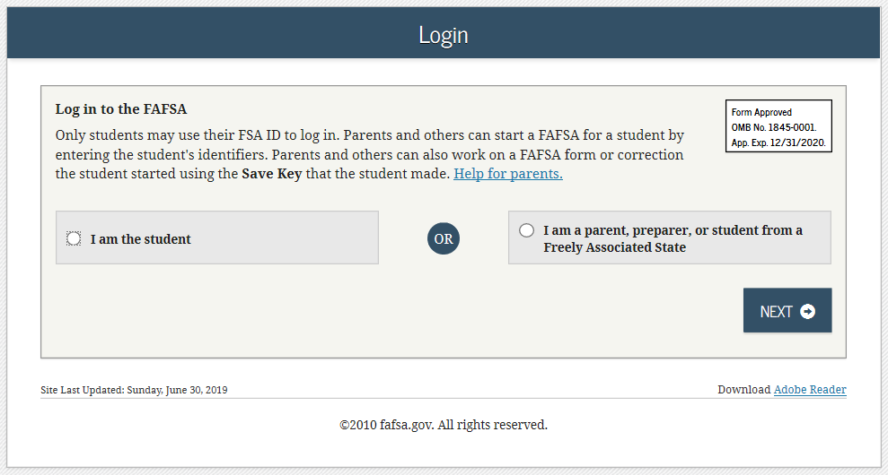
FAFSA on the Web(FOTW)

Slide 25
Student Dependency Status
FAFSA asks questions to determine dependency status for Title IV federal student aid (not IRS) purposes:
If all “No” responses, student is dependent
If “Yes” to any question, student is independent

Slide 26
Avoid Errors!
Errors made in completing the FAFSA and/or supplemental forms may delay application processing and result in the loss of financial aid funds.
  Please complete all forms carefully!

Slide 27
The Application Process Continues (State Aid)
Tap Application
  May complete immediately after doing FAFSA on the Web at: https://www.tapweb.org/totw
  For New York residents that list at least one college located in New York State on FAFSA.

Slide 28
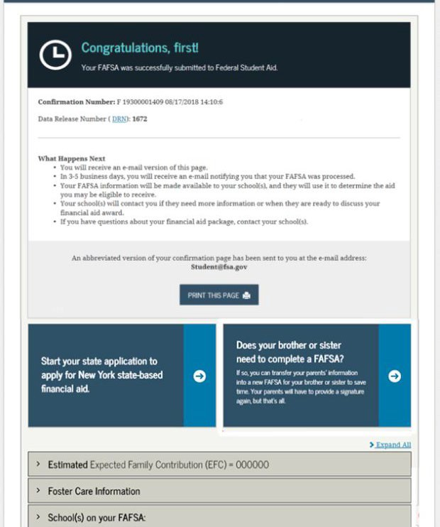
FAFSA Confirmation Page and TAP Link

Slide 29
FAFSA Processing Results
To Student
Central Processing System (CPS) notifies student of FAFSA processing results by:
  Paper Student Aid Report (SAR)
  E-mail notification containing a direct link
  Student with FSA ID may view SAR on-line at https://studentaid.gov

Slide 30



FAFSA Processing Results
CPS
College
Student

Slide 31
Making Corrections
Review data for accuracy
If necessary, corrections to FAFSA data may be made by:
  Using FAFSA on the Web (https://studentaid.gov ) if student has a FSA ID or
  Use IRS Data Retrieval Process
  Updating paper SAR or
  Submitting documentation to college’s financial aid office

Slide 32

Special Circumstances
Unusual uncovered medical/dental expenses
Secondary school tuition
Extraordinary dependent care
Parent or spouse death
Loss of employment
Divorce

Slide 33
Special Circumstances continued
Send explanation to Financial Aid Office at each college
Varies from school to school
School will ask for documentation
This process is done AFTER initial award is made
Decisions are final and cannot be appealed

Slide 34
What To Expect
Check your email!
Student Aid Report (SAR)
Estimated Award Letter
Award Letter
Loan Promissory Notes – electronic and paper
TAP award notice from HESC after state budget passes

Slide 35
Helpful Web Resources
Federal Student Aid
https://studentaid.gov
Apply for FSA ID
Stafford/PLUS Electronic Promissory Note
Entrance and Exit Counseling
Complete PLUS Request Process
NYS Higher Education Services
https://www.hesc.ny.gov

Slide 36
Contact Information
Financial Aid Office
SUNY Brockport
350 New Campus Drive
Brockport, NY 14420
Phone: (585) 395-2501
Fax: (585) 395-5445
faid@brockport.edu
Web site: www.brockport.edu/finaid

Slide 37
QUESTIONS?

